Slide 1
Single-Source Shortest Paths
Given: A single source vertex in a weighted, directed graph.
Want to compute a shortest path to each possible destination from the source.
We assume either
no negative-weight edges, or
no reachable negative-weight cycles.
Algorithm will compute a shortest-path tree.
Notes:
1

Slide 2
Example
u
v
5
∞
∞
-2
6
-3
8
s
0
7
-4
7
2
∞
∞
9
x
y
Notes:
2

Slide 3
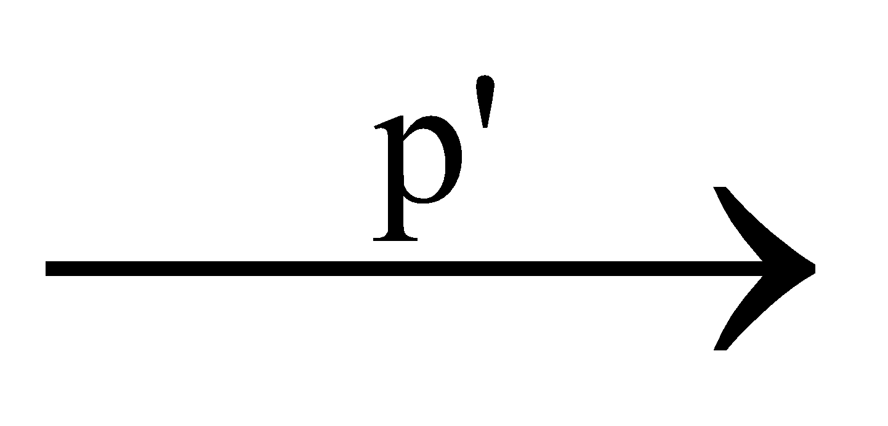
General Results (Relaxation)
Lemma 24.1: Let p = ‹v₁, v₂, …, v_{k}› be a SP from v₁ to v_{k}. Then,
p_{ij} = ‹v_{i}, v_{i+1}, …, v_{j}› is a SP from v_{i} to v_{j}, where 1 ≤ i ≤ j ≤ k.
Corollary: Let p = SP from s to v, where p = s u →v. Then, δ(s, v) = δ(s, u) + w(u, v).
Lemma 24.10: Let s ∈ V. For all edges (u,v) ∈ E, we have. δ(s, v) ≤ δ(s, u) + w(u,v).
Comp 122, Fall 2003
Single-source SPs - 3
Notes:
3

Slide 4
Relaxation
Algorithms keep track of d[v], π[v]. Initialized as follows:
Initialize(G, s)
for each v ∈ V[G] do
d[v] := ∞;
π[v] := NIL
od;
d[s] := 0
These values are changed when an edge (u, v) is relaxed:
Relax(u, v, w)
if d[v] > d[u] + w(u, v) then
d[v] := d[u] + w(u, v);
π[v] := u
fi
Notes:
4

Slide 5
Bellman Ford Algorithm
Given: A single source vertex in a weighted, directed graph.
Can contain negative edges weights and reachable *negative weight cycles.
Want to compute a shortest path for each possible destination.
Algorithm will compute a shortest-path tree.
Comp 122, Fall 2003
Single-source SPs - 5
Notes:
5

Slide 6
Negative Weight cycle
negative-weight cycle in graph: Some shortest paths may not be defined
argument:can always get a shorter path by going around the cycle again
cycle
< 0
s
v
LectureX
CS473
6
Notes:
6

Slide 7
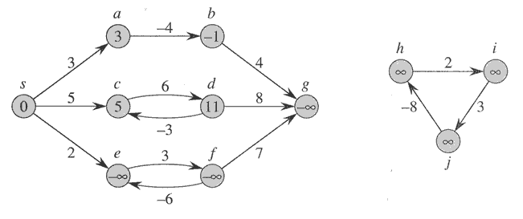
Negative-weight edges
we can just keep going around it, and
get w(s, v) = −∞ for all v on the cycle.
LectureX
CS473
7
Notes:
7

Slide 8
General Results (Relaxation)
Lemma 24.1: Let p = ‹v₁, v₂, …, v_{k}› be a SP from v₁ to v_{k}. Then,
p_{ij} = ‹v_{i}, v_{i+1}, …, v_{j}› is a SP from v_{i} to v_{j}, where 1 ≤ i ≤ j ≤ k.
Corollary: Let p = SP from s to v, where p = s u →v. Then, δ(s, v) = δ(s, u) + w(u, v).
Lemma 24.10: Let s ∈ V. For all edges (u,v) ∈ E, we have
δ(s, v) ≤ δ(s, u) + w(u,v).
Comp 122, Fall 2003
Single-source SPs - 8
Notes:
8

Slide 9
Example
u
v
5
∞
∞
–2
6
–3
8
z
0
7
–4
7
2
∞
∞
9
x
y
Comp 122, Fall 2003
Single-source SPs - 9
Notes:
9

Slide 10
Shortest Path
u
v
∞
∞
–2
–3
0
–4
7
∞
∞
x
y

Slide 11
Relaxation
Algorithms keep track of d[v], π[v]. Initialized as follows:
Initialize(G, s)
for each v ∈ V[G] do
d[v] := ∞;
π[v] := NIL
od;
d[s] := 0
These values are changed when an edge (u, v) is relaxed:
Relax(u, v, w)
if d[v] > d[u] + w(u, v) then
d[v] := d[u] + w(u, v);
π[v] := u
fi
Notes:
11

Slide 12
Bellman-Ford Algorithm
Can have negative-weight edges. Will “detect” reachable negative-weight
cycles.
Initialize(G, s);
for i := 1 to |V[G]| –1 do
for each (u, v) in E[G] do
Relax(u, v, w)
od
od;
for each (u, v) in E[G] do
if d[v] > d[u] + w(u, v)
return false
fi
od;
return true
Time
Complexity
is O(VE).
Notes:
12

Slide 13
Example
u
v
5
∞
∞
–2
6
–3
8
z
0
7
–4
7
2
∞
∞
9
x
y
Comp 122, Fall 2003
Single-source SPs - 13
Notes:
13

Slide 14
Example
u
v
5
6
∞
–2
6
–3
8
z
0
7
–4
7
2
7
∞
9
x
y
Comp 122, Fall 2003
Single-source SPs - 14
Notes:
14

Slide 15
Example
u
v
5
6
4
–2
6
–3
8
z
0
7
–4
7
2
7
2
9
x
y
Comp 122, Fall 2003
Single-source SPs - 15
Notes:
15

Slide 16
Example
u
v
5
2
4
–2
6
–3
8
z
0
7
–4
7
2
7
2
9
x
y
Comp 122, Fall 2003
Single-source SPs - 16
Notes:
16

Slide 17
Example (2nd iteration)
u
v
5
2
4
–2
6
–3
8
z
0
7
–4
7
2
7
-2
9
x
y
Comp 122, Fall 2003
Single-source SPs - 17
Notes:
17

Slide 18
Shortest Path Tree
u
v
∞
∞
–2
–3
0
–4
7
∞
∞
x
y

Slide 19
Bellman-Ford Algorithm
Can have negative-weight edges. Will “detect” reachable negative-weight
cycles.
Initialize(G, s);
for i := 1 to |V[G]| –1 do
for each (u, v) in E[G] do
Relax(u, v, w)
od
od;
for each (u, v) in E[G] do
if d[v] > d[u] + w(u, v) then
return false
fi
od;
return true
Time
Complexity
is O(VE).
Single-source SPs - 19
Notes:
19

Slide 20
So if Bellman-Ford has not converged after V(G) - 1 iterations, then there cannot be a shortest path tree, so there must be a negative weight cycle.
Single-source SPs - 20
Notes:
20

Slide 21
Dijkstra’s Algorithm
Assumes no negative-weight edges.
Maintains a set S of vertices whose SP from s has been determined.
Repeatedly selects u in V–S with minimum SP estimate (greedy choice).
Store V–S in priority queue Q.
Initialize(G, s);
S := ∅;
Q := V[G];
while Q ≠ ∅ do
u := Extract-Min(Q);
S := S ∪ {u};
for each v ∈ Adj[u] do
Relax(u, v, w)
od
od
Comp 122, Fall 2003
Single-source SPs - 21
Notes:
21

Slide 22
Example
u
v
∞
1
∞
10
9
2
3
s
0
4
6
5
7
∞
∞
2
x
y
Comp 122, Fall 2003
Single-source SPs - 22
Notes:
22

Slide 23
Example
u
v
10
1
∞
10
9
2
3
s
0
4
6
5
7
5
∞
2
x
y
Comp 122, Fall 2003
Single-source SPs - 23
Notes:
23

Slide 24
Example
u
v
8
1
14
10
9
2
3
s
0
4
6
5
7
5
7
2
x
y
Comp 122, Fall 2003
Single-source SPs - 24
Notes:
24

Slide 25
Example
u
v
8
1
13
10
9
2
3
s
0
4
6
5
7
5
7
2
x
y
Comp 122, Fall 2003
Single-source SPs - 25
Notes:
25

Slide 26
Example
u
v
8
1
9
10
9
2
3
s
0
4
6
5
7
5
7
2
x
y
Comp 122, Fall 2003
Single-source SPs - 26
Notes:
26

Slide 27
Example
u
v
8
1
9
10
9
2
3
s
0
4
6
5
7
5
7
2
x
y
Comp 122, Fall 2003
Single-source SPs - 27
Notes:
27

Slide 28
Correctness-Lini
Theorem 24.6: Upon termination, d[u] = δ(s, u) for all u in V
(assuming non-negative weights).
Proof:
By induction we would like to assume that till now all u in S
have d[u]= δ(s, u) and we need to prove that a new node x entering S has d[x]=δ(s, x) For this we need to prove two things 1. There can not be shorter path involving some y outside S such that δ(s, x)= δ(s, u)+ d[u,y] +d[y,x] That is, the shortest path δ(s, x) will contain only nodes in S (as in Dijkstra) 2. Prove that δ(s, u) will not require any recomputation of distance among nodes in S since if δ(s, u) changes once some y enters S last then I should be checking also d[s🡪y🡪u🡪x] and not just d[s->u🡪.x] for all u in S
Notes:
28

Slide 29
By induction Base case source node s when added has shortest path Assume that all nodes currently in S have correct shortest distance. –(assumption) we are now wanting to add the node u to S which has minimum value among vertices in V. If shortest path to u is via nodes in S then u has the correct shortest path currently as u is at one home from a node in S which has its correct shortest path (assumption statement above). If shortest path to u is via a node y outside S such that x is the last node in S on the shortest path to u then
δ[u]<=d[u]-----1 always true
d[u]<=d[y]-----2 : current situation because of which we are wanting to pick u to add to S
δ[y]<= δ[u] ----3 because we claim y is on the shortest path to u
Putting 1,2,3 together we have δ[y]<= δ[u] <=d[u]<=d[y] ---4 Now consider the situation when we relaxed the node x. we would have relaxed the edge xy. Hence y would have found its shortest distance at that point. Hence current δ[y]=d[y]. Putting this in 4 we have δ[u] =d[u] That is, current u has the shortest distance from the source.

Slide 30
Prove by contradiction
We know δ[u]<=d[u] -----1
At this point d[u]<=d[y] ----2 (that is why you are selecting u.)
Suppose shortest path to u is via y where y not in S and x is the last vertex in S on shortest path to u; then; δ[y]<=δ[u]----3
Thus, δ[y]<= δ[u]<=d[u] <=d[y] -----4 (from 1,2,3)
Now when x in S was relaxed then at that point d[y]= δ[y] (since by our assumption the shortest path to y is via s)
Thus, , δ[y]= δ[u]=d[u] =d[y] (from 4 and previous statement)
Proved δ[u]=d[u] when u was being inserted even if via intermediary vertex y not in S. and w(u,y)=0

Slide 31
Suppose shortest path to u is via y not in S
There exists a path from s to u, for otherwise d[u] = δ(s, u) = ∞
Suppose d[u] has the minimum value on it from some vertex v in S but the actual shortest path from s to u looks like as below:
u
v
_{P2}
y
s
_{P1}
x
S
Comp 122, Fall 2003
Single-source SPs - 31
Notes:
31

Slide 32
Proof (Continued)
Claim: d[y] = δ(s, y) when u is inserted into S.
We had d[x] = δ(s, x) when x was inserted into S.
Edge (x, y) was relaxed at that time.
By Lemma 24.14, this implies the claim.
Now, we have: d[y] = δ(s, y) , by Claim.
≤ δ(s, u) , nonnegative edge weights.
≤ d[u] , by Lemma 24.11.
Because u was added to S before y, d[u] ≤ d[y].
Thus, d[y] = δ(s, y) = δ(s, u) = d[u].
Contradiction.
Comp 122, Fall 2003
Single-source SPs - 32
Notes:
32

Slide 33
Suppose shortest path from within S would change based
On last node inserted which is x
u
y
p₂
s
p₁
x
S
Concern: If x was the last node to enter could there be a shorter path through x to one of the seen nodes (say y) to u which
would be shorter than s to x to u or s to y to u ?
Single-source SPs - 33
Notes:
33

Slide 34
Suppose shortest path from within S would change based
On last node inserted which is x
u
y
p₂
s
p₁
Concern: If x was the last node to enter could there be a shorter path through x to one of the seen nodes (say y) to u which would be shorter than s to x to u or s to y to u ? Not possible. By induction we have assumed that till now all nodes in S are at shortest distance and we want to prove that the new node that enters is at shortest distance. So since all nodes so far are at shortest distance and y entered before x so d[y] without x is the shortest distance and not s->x->y.
x
S
Single-source SPs - 34
Notes:
34

Slide 35
Complexity
Dijkstra Operations are :
Relax (total E edges that will be relaxed)
Update: A relaxation might lead to an update of node distance
PickMin: Each iteration pick node which is min distance away.
Relax Update PickMin
Array E 1 X E V x V
Heap E log V X E log V X V
Cost of update in Array is O(1) and in Heap is log(V) since you might
need to delete and reheap so that the new value falls in the right place.
The number of updates is the number of relaxations = O(E)
Cost of PickMin in array is O(V) in array and O(log V) in heap
The number of PickMin operations is O(V)
Comp 122, Fall 2003
Single-source SPs - 35
Notes:
35

